Slide 1
Overview

Slide 2




Slide 3



Slide 4



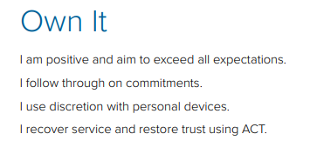


Slide 5

Overview
1973
AdventHealth was established
50
● Hospital campuses operated in nine states
80,000+
Employees and physicians
5.5 million +
Patients served annually
10
● Skilled nursing facilities
17
● Home health and hospice agencies
Currently one of the largest non-for-profit Protestant health care providers.
Notes:
With a sacred mission of Extending the Healing Ministry of Christ, AdventHealth is a connected system of care for every stage of life and health.
More than 80,000 skilled and compassionate caregivers in physician practices, hospitals, outpatient clinics, skilled nursing facilities, home health agencies and hospice centers provide individualized, wholistic care.
A shared vision, common values, focus on whole-person health and commitment to making communities healthier unify the system's nearly 50 hospital campuses and hundreds of care sites in diverse markets throughout almost a dozen states.

Slide 6










Sports & Entertainment Partnerships

Slide 7


Local Impact
We recently became a gold level sponsor to Salt Outreach! An Adventist non-for-profit organization dedicated to helping the Orlando homeless community with necessities and starting their journey to being homebound.

Slide 8
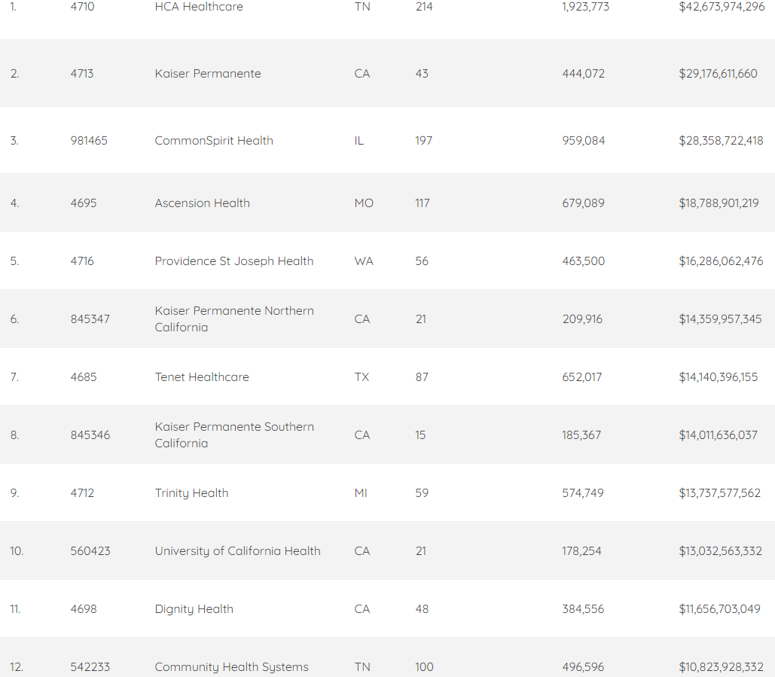
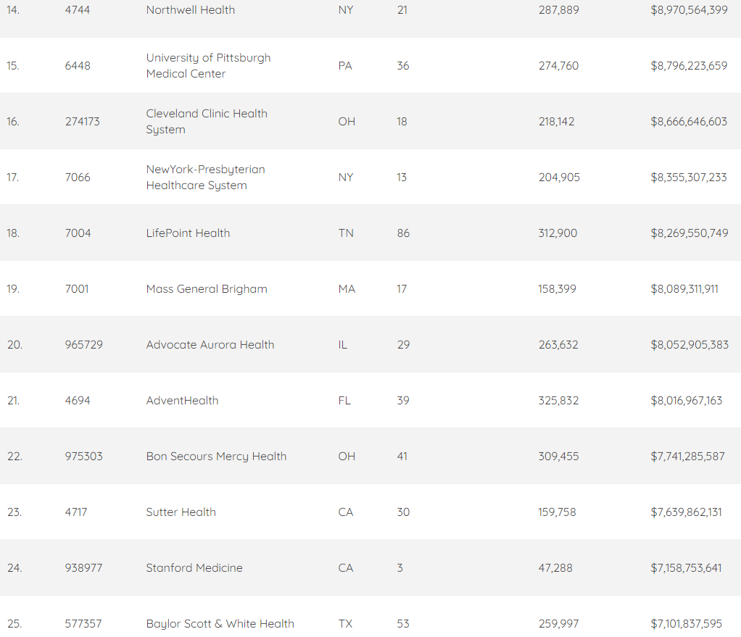

National Net Revenue Ranking

Slide 9






Executive Office
Terry Shaw – President/CEO
David Moorhead – EVP Chief Clinical Officer
David Banks – SEVP Chief Strategy & Organizational Transformation Officer
Paul Rathbun – SEVP CFO Corp
Jeff Bromme – VP Chief Legal Officer
Sandra Johnson – EVP Chief Admin Officer

Slide 10
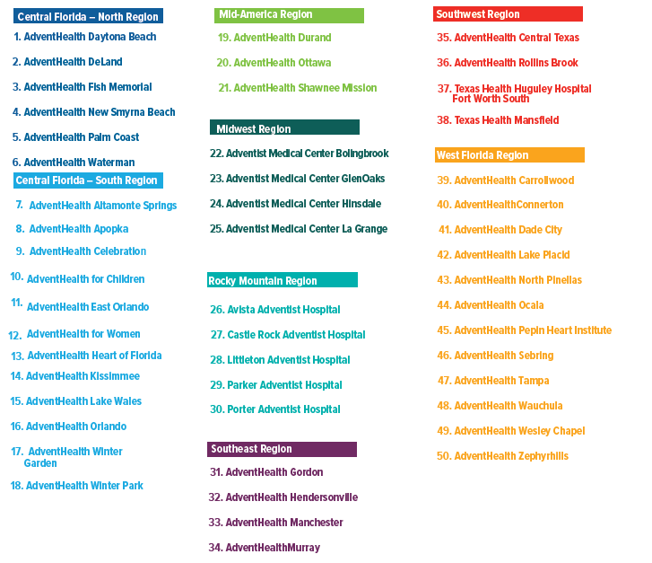
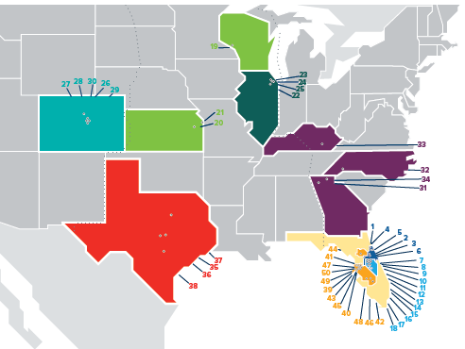
Locations

Slide 11
AdventHealth Hospitals
50 Campuses
9 States
9,500+ Licensed Beds
Notes:
AdventHealth has 50 campuses in nine states with more than 9,500 licensed beds.

Slide 12
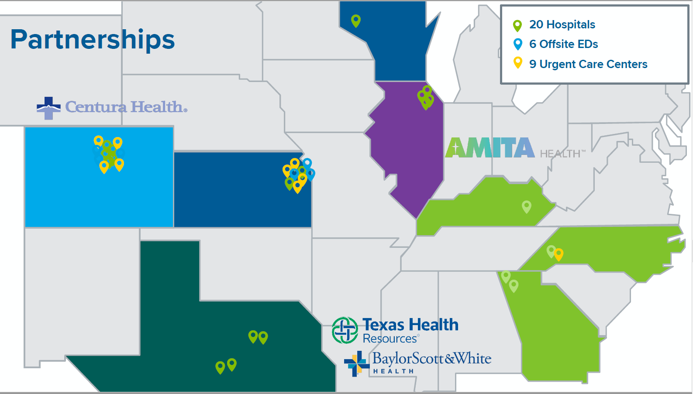

Slide 13
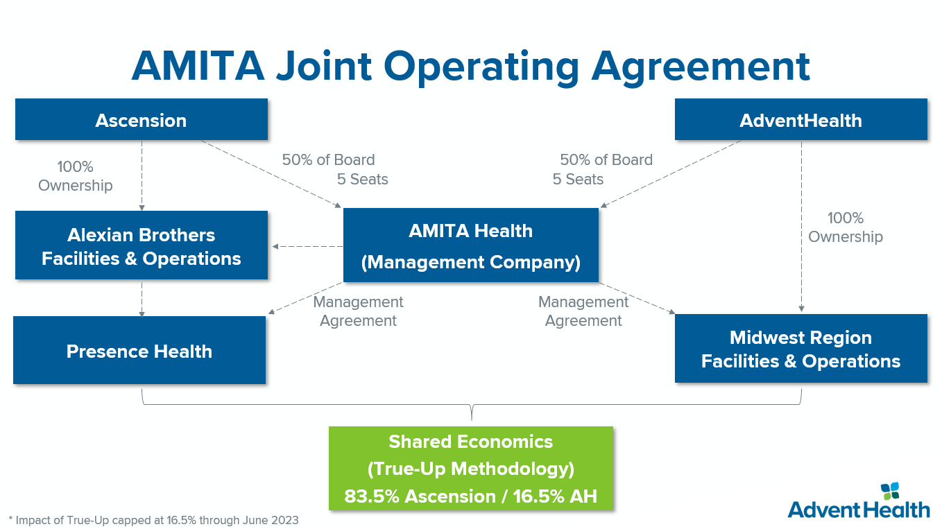

Slide 14
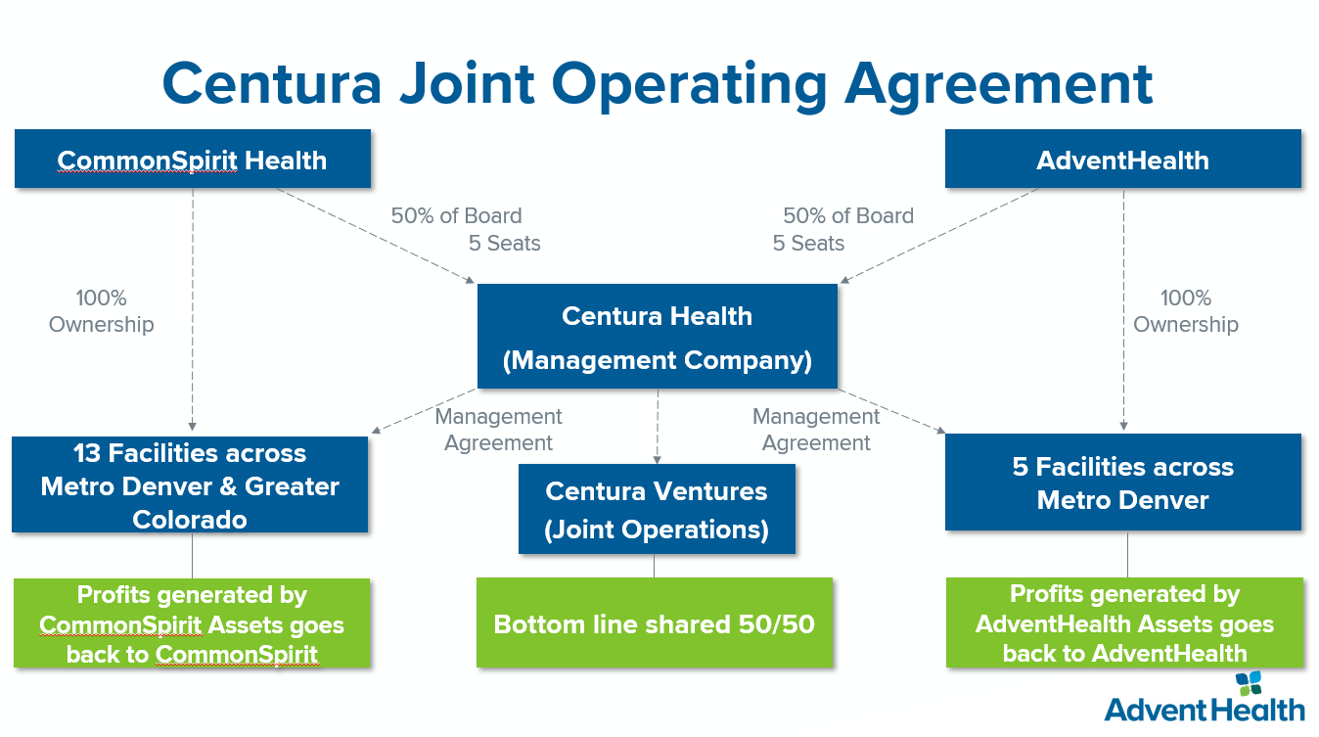

Slide 15
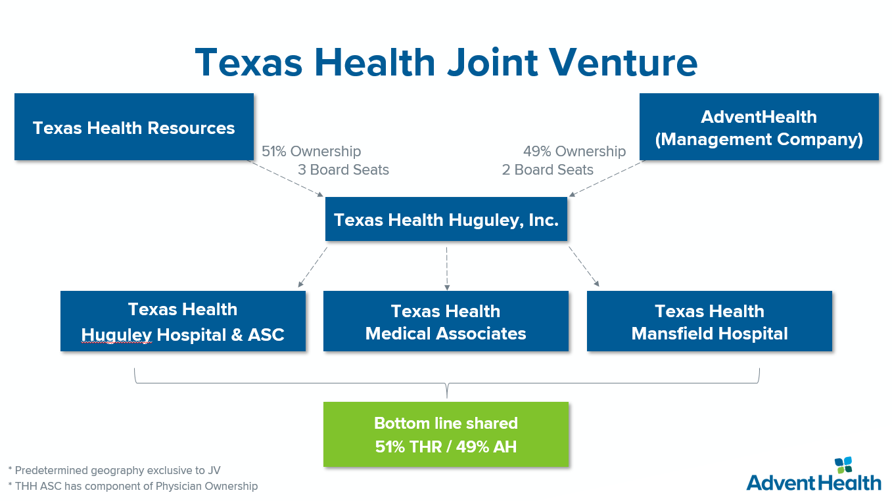

Slide 16

AdventHealth Regions
● Central Florida — North Region
● Central Florida — South Region
● Midwest Region
● Rocky Mountain Region
● Mid-America Region
● Southeast Region
● Southwest Region
● West Florida Region
Notes:
Within the three divisions, AdventHealth is organized into eight regions:
Central Florida -- North Region, with seven hospitals
Central Florida -- South Region, with nine hospitals
Mid-America Region, with two hospitals
Midwest Region, with four hospitals
Rocky Mountain Region, with five hospitals
Southeast Region, with four hospitals
Southwest Region, with four hospitals
West Florida Region, with 12 hospitals
AdventHealth is headquartered is in Altamonte Springs, Florida.

Slide 17




AdventHealth Divisions
Central Florida Division
Randy Haffner, President/CEO
West Florida Division
Mike Schultz, President/CEO
Multi-State Division
Ken Bacon, President/CEO
Notes:
AdventHealth comprises three divisions:
Central Florida Division
Home to AdventHealth Orlando
Sixteen facilities with 4,117 beds
West Florida Division
Twelve facilities with 1,897 beds
Multi-State Division
Eight states
Nineteen facilities with 3,259 beds

Slide 18


Central Florida Division
Central Florida Division
Randy Haffner
North Region
David Ottati
South Region
Jennifer Wandersleben
Notes:
The Central Florida Division is organized into two regions:
North Region, with seven hospitals
South Region, with nine hospitals
Randy Haffner is the senior leader over the Central Florida Division.

Slide 19
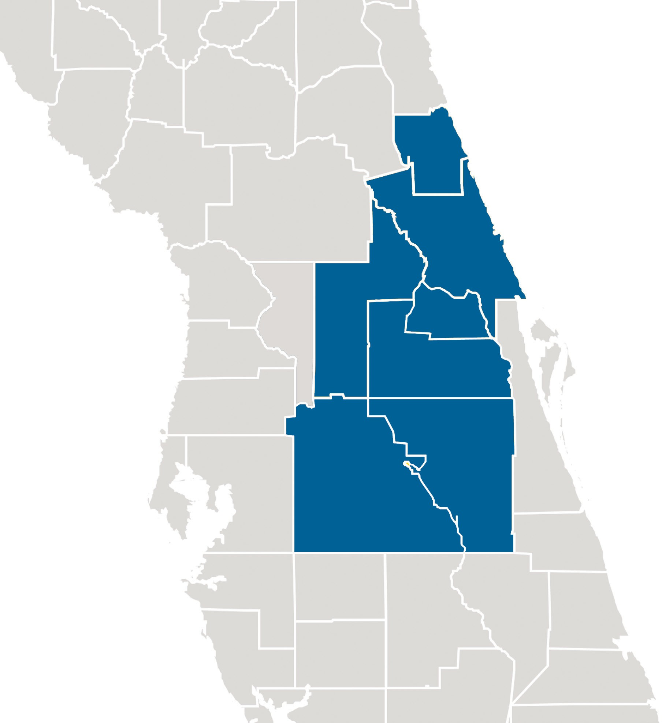
Central Florida Division
18 Hospitals
2,211,719 Outpatient visits
200,597 Inpatient visits
624,802 ED visits
4,589 Beds
Notes:
Source: 2020 Finance Summary

Slide 20

West Florida Division
West Florida Division
Mike Schultz
Notes:
The West Florida Division is organized into one region:
West Florida Region, 12 hospitals
Mike Schultz is the senior leader over the West Florida Division.

Slide 21
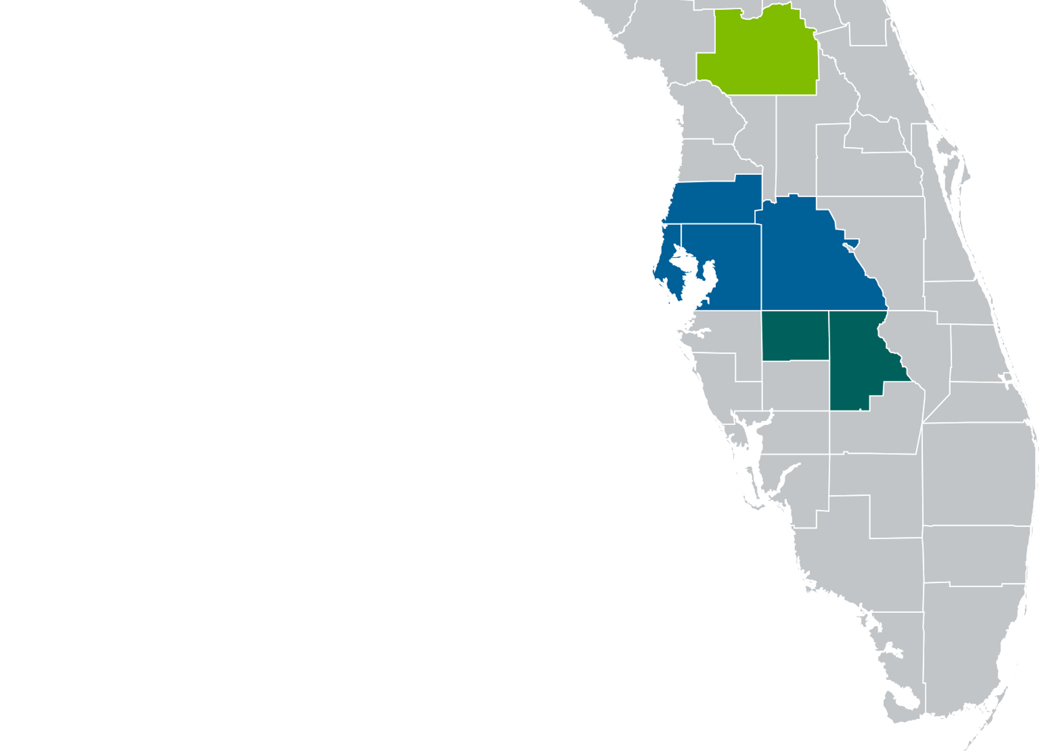
West Florida Division
Ocala
Region
12 Hospitals
367,904 Outpatient visits
83,428 Inpatient visits
295,970 ED visits
1,941 Beds
Tampa Bay
Region
Heartland
Region
Notes:
Source: 2020 Finance Summary

Slide 22






Multi-State Division
Mid-America Region
Sam Huenergardt
Midwest Region
Keith Parrott
Rocky Mountain Region
Peter Banko
Southeast Region
Michael Murrill
Southwest Region
Penny Johnson
Notes:
Multi-State Division is organized into five regions:
Mid-America Region, with two hospitals
Midwest Region, with four hospitals
Rocky Mountain Region, with five hospitals
Southeast Region, with four hospitals
Southwest Region, with four hospitals
Randy Haffner is the senior leader over the Multi-State Division.

Slide 23
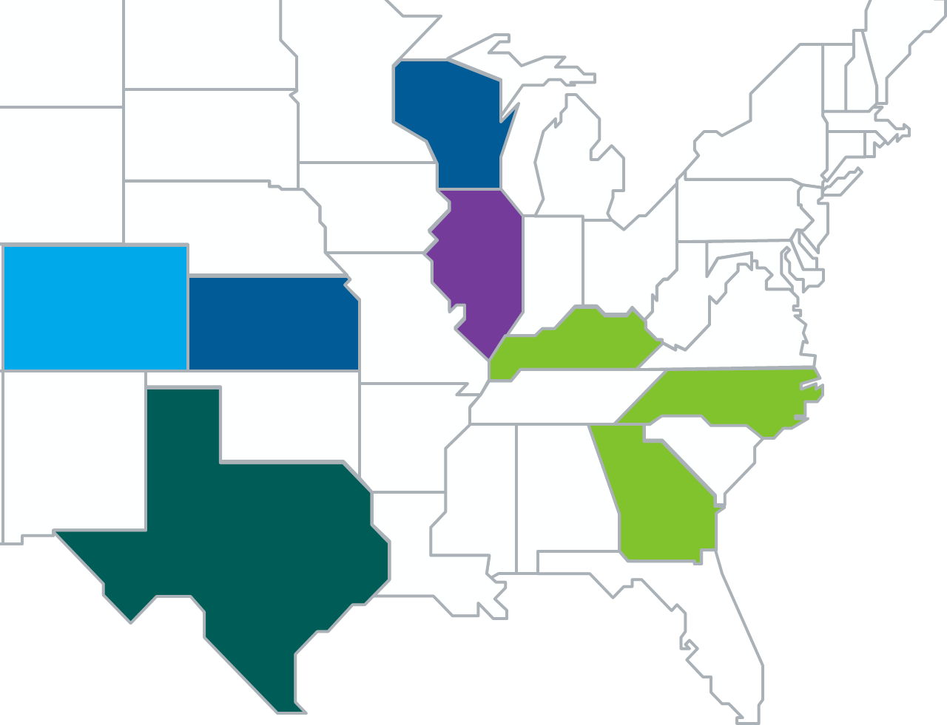
Multi-State Division
20 Hospitals
1,184,696 Outpatient visits
104,543 Inpatient visits
357,801 ED visits
2,927 Beds
Rocky Mountain Region
Midwest Region
Mid-America Region
Southeast Region
Southwest Region
Notes:
Source: 2020 Finance Summary
Add +1 hospital to the total (Texas Health Mansfield)

Slide 24
AdventHealth Home Care
17 Agencies
6 States
Notes:
AdventHealth has a home care network
Locations in Florida, Georgia, Illinois, Kansas, Kentucky, North Carolina, Tennessee and Texas

Slide 25
AdventHealth Care Center
10 Facilities
1,335 Beds
Notes:
AdventHealth supports Adventist Care Centers, a network of nursing and rehab facilities
Locations in Florida, Texas and Kansas

Slide 26



Seventh-day Adventist Healthcare Worldwide
Notes:
The commitment and philosophy of the original medical pioneers continue today in nearly 600 Seventh-day Adventist hospitals, nursing homes and clinics around the globe.

